Slide 1
Token Ring/IEEE 802.5

Slide 2
The Token Ring network was originally developed by IBM in the 1970s.
It is still IBM’s primary local-area network (LAN) technology.
The related IEEE 802.5 specification is almost identical to and completely compatible with IBM’s Token Ring network.
In fact, the IEEE 802.5 specification was modeled after IBM Token Ring, and it continues to shadow IBM’s Token Ring development.
The term Token Ring generally is used to refer to both IBM’s Token Ring network and IEEE 802.5 networks.

Slide 3
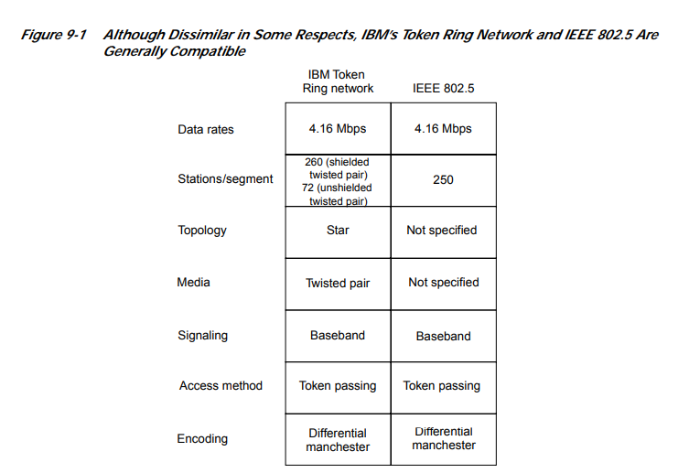

Slide 4
concept
Token-passing networks move a small frame, called a token, around the network.
Possession of the token grants the right to transmit.
If a node receiving the token has no information to send, it passes the token to the next end station.
Each station can hold the token for a maximum period of time.

Slide 5
If a station possessing the token does have information to transmit, it seizes the token, alters 1 bit of the token (which turns the token into a start-of-frame sequence), appends the information that it wants to transmit, and sends this information to the next station on the ring.
While the information frame is circling the ring, no token is on the network (unless the ring supports early token release), which means that other stations wanting to transmit must wait.
Therefore, collisions cannot occur in Token Ring networks.
If early token release is supported, a new token can be released when frame transmission is complete.

Slide 6
The information frame circulates the ring until it reaches the intended destination station, which copies the information for further processing.
The information frame continues to circle the ring and is finally removed when it reaches the sending station.
The sending station can check the returning frame to see whether the frame was seen and subsequently copied by the destination.

Slide 7
Priority System
Token Ring networks use a sophisticated priority system that permits certain user-designated, high-priority stations to use the network more frequently.
Token Ring frames have two fields that control priority: the priority field and the reservation field.
Only stations with a priority equal to or higher than the priority value contained in a token can seize that token.
After the token is seized and changed to an information frame, only stations with a priority value higher than that of the transmitting station can reserve the token for the next pass around the network.
When the next token is generated, it includes the higher priority of the reserving station.
Stations that raise a token’s priority level must reinstate the previous priority after their transmission is complete.

Slide 8
Fault-Management Mechanisms
Token Ring networks employ several mechanisms for detecting and compensating for network faults.
For example, one station in the Token Ring network is selected to be the active monitor.
This station, which potentially can be any station on the network, acts as a centralized source of timing information for other ring stations and performs a variety of ring-maintenance functions.
One of these functions is the removal of continuously circulating frames from the ring.
When a sending device fails, its frame(orphan packet problem) may continue to circle the ring.
This can prevent other stations from transmitting their own frames and essentially can lock up the network.
The active monitor can detect such frames, remove them from the ring, and generate a new token.

Slide 9
Frame Format
Token Ring and IEEE 802.5 support two basic frame types: tokens and data/command frames.
Tokens are 3 bytes in length and consist of a start delimiter, an access control byte, and an end delimiter.
Data/command frames vary in size, depending on the size of the Information field. Data frames carry information for upper-layer protocols, while command frames contain control information and have no data for upper-layer protocols.

Slide 10
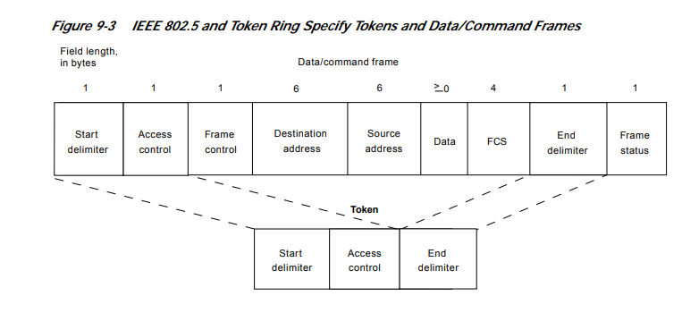

Slide 11
Token Frame Fields
Start delimiter—Alerts each station of the arrival of a token (or data/command frame).
Access-control byte—Contains the Priority field (the most significant 3 bits) and the Reservation field (the least significant 3 bits), as well as a token bit (used to differentiate a token from a data/command frame) and a monitor bit (used by the active monitor to determine whether a frame is circling the ring endlessly).
End delimiter—Signals the end of the token or data/command frame.

Slide 12
Data/Command Frame Fields
Start delimiter—Alerts each station of the arrival of a token (or data/command frame).
• Access-control byte—Contains the Priority field (the most significant 3 bits) and the Reservation field (the least significant 3 bits), as well as a token and a monitor bit.
• Frame-control bytes—Indicates whether the frame contains data or control information. In control frames, this byte specifies the type of control information.
• Destination and source addresses—Consists of two 6-byte address fields that identify the destination and source station addresses.
• Data—Indicates that the length of field is limited by the ring token holding time, which defines the maximum time a station can hold the token.

Slide 13
Frame-check sequence (FCS)—Is filed by the source station with a calculated value dependent on the frame contents. The destination station recalculates the value to determine whether the frame was damaged in transit. If so, the frame is discarded.
• End Delimiter—Signals the end of the token or data/command frame. The end delimiter also contains bits to indicate a damaged frame and identify the frame that is the last in a logical sequence.
• Frame Status—Is a 1-byte field terminating a command/data frame. The Frame Status field includes the address-recognized indicator and frame-copied indicator.

